Slide 1
Example
Lifespan and Metabolism

Slide 2



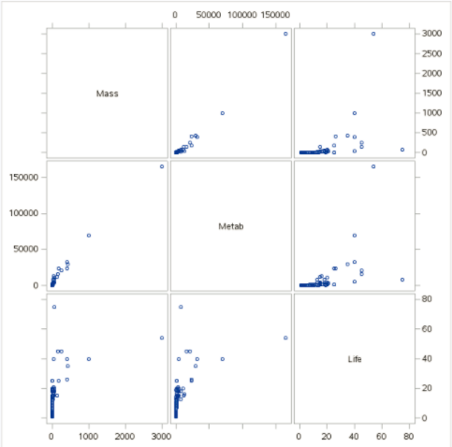
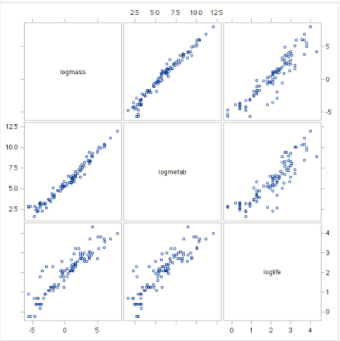
First Step: Plot the Data

Slide 3
Second Step: Construct a Model
Is metabolic rate a useful predictor of lifespan after accounting for the effect of body mass? Describe the dependence of the distribution of life span on metabolic rate for species of similar body mass.
$$pred \log\left(life\right)= β_{0}+β_{1}log⁡(metab)+β_{2}log⁡(mass)$$
There is no interaction term right now as we are simply putting mass in the model in order to adjust for its effects.

Slide 4

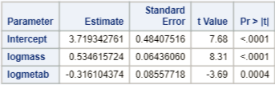
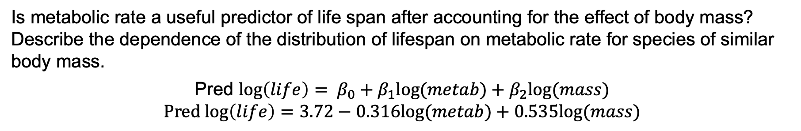
Third Step: Fit the Model
Is metabolic rate a useful predictor of life span after accounting for the effect of body mass? Describe the dependence of the distribution of lifespan on metabolic rate for species of similar body mass.
Pred $\log\left(life\right)= β_{0}+β_{1}log⁡(metab)+β_{2}log⁡(mass)$
$$Pred log\left(life\right)=3.72−0.316log⁡(metab)+0.535log⁡(mass)$$
Both terms are significant so we leave both terms in the model.

Slide 5
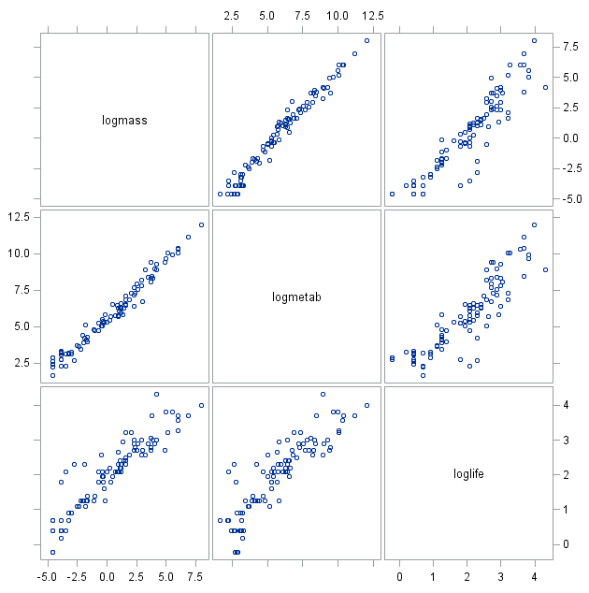
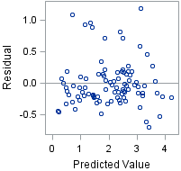
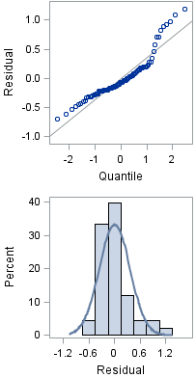
Fourth Step: Check the Assumptions
$$Pred log\left(life\right)=3.72−0.316log⁡(metab)+0.535log⁡(mass)$$
Normality:
Judging from scatter plot, Q-Q plot, and histogram of residuals, there is some right skew but not strong enough evidence against normality.
Linear trend:
It is tough to check linearity in multiple dimensions, although checking pairwise scatter plots indicates a strong linear trend between each log(Exp. Var.) and log(life).
Equal SD:
There is little evidence from the residual scatter plot of heteroscedasticity.
Independence:
We will assume the observations are independent.

Slide 6
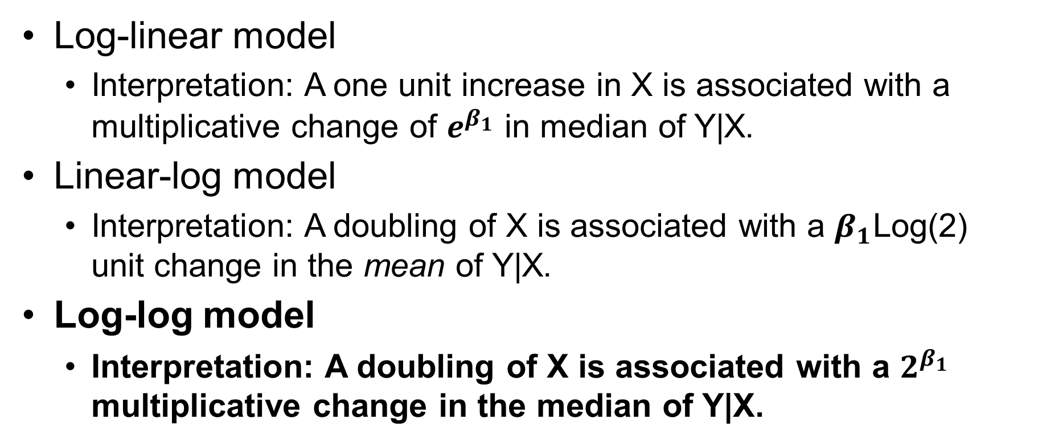
Log Transformation Interpretations
Log-linear model
Interpretation: A one unit increase in X is associated with a multiplicative change of $e^{β_{1}}$ in median of Y|X.
Linear-log model
Interpretation: A doubling of X is associated with a $β_{1}$Log(2) unit change in the mean of Y|X.
Log-log model
Interpretation: A doubling of X is associated with a $2^{β_{1}}$ multiplicative change in the median of Y|X.

Slide 7
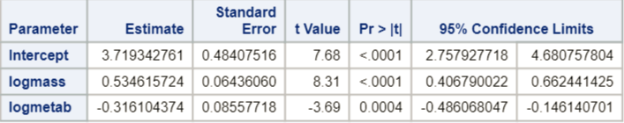
Fifth Step: Interpret
Is metabolic rate a useful predictor of lifespan after accounting for the effect of body mass? Describe the dependence of the distribution of lifespan on metabolic rate for species of similar body mass.
$$Pred log\left(life\right)=3.72−0.316log⁡(metab)+0.535log⁡(mass)$$
A convenient change in metabolism is a 10-fold increase. Holding body mass constant, it is estimated that a 10-fold increase in metabolism is associated with a (10^{−.31610} = 0.48) 52% decrease in the median lifespan (p-value = 0.0004). A 95% confidence interval for the multiplicative decrease is (10^{−.48607},10^{−.14614}) = (.33, .71) which equates to an estimated decrease in lifespan between 29% and 67%.

Slide 9
Two Indicator Variable Interaction

Slide 10
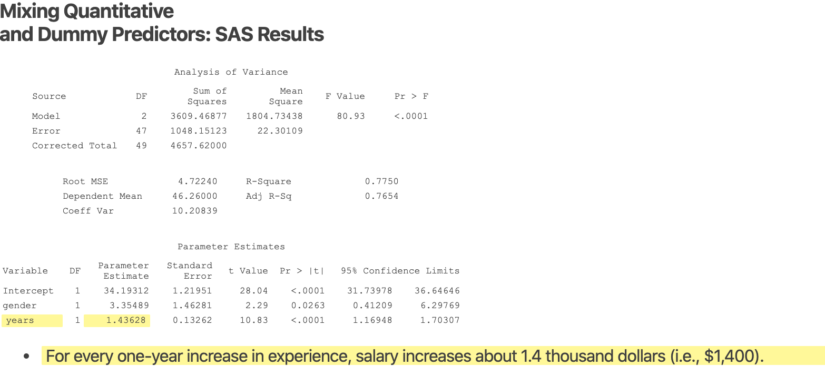

Slide 11
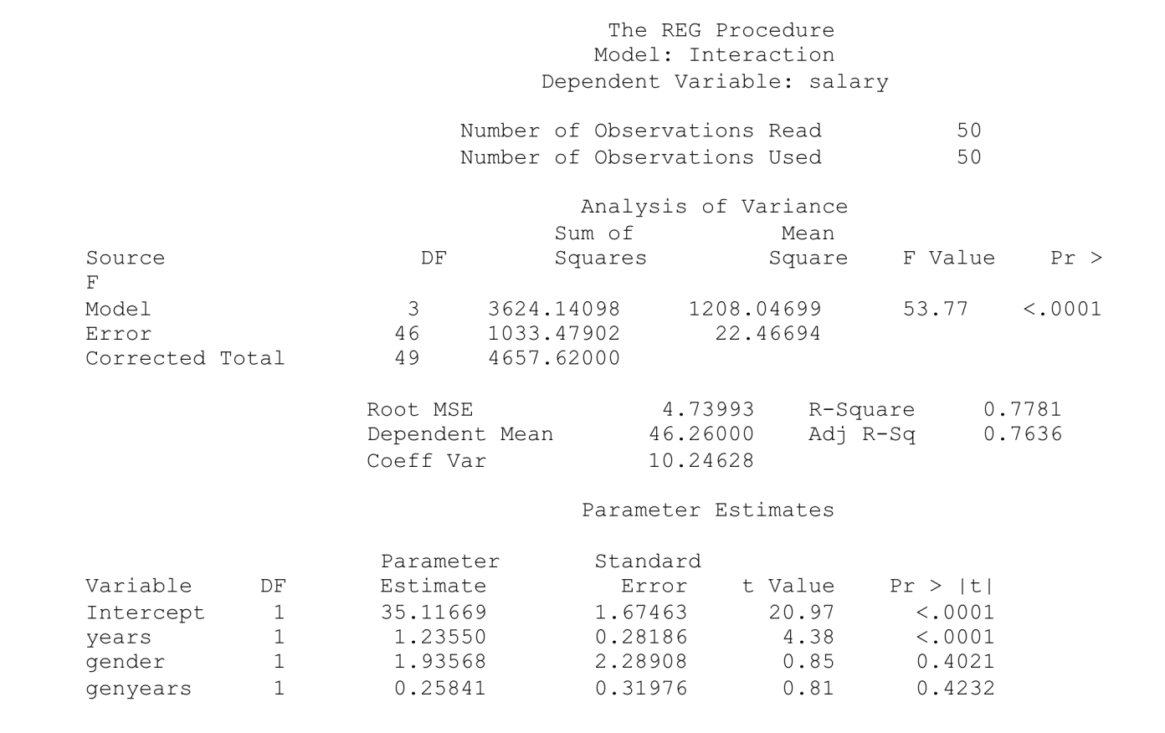

Slide 13
Example
Meadowfoam

Slide 14

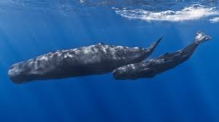
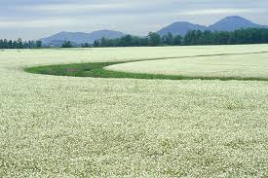
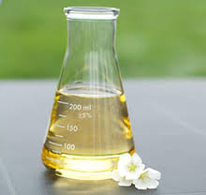
Case 1: Meadowfoam
Data from: Seddigh, M. and G. D. Jolliﬀ. 1994. “Light Intensity Eﬀects on Meadowfoam Growth and Flowering.” Crop Science 34: 497–503.

Slide 15
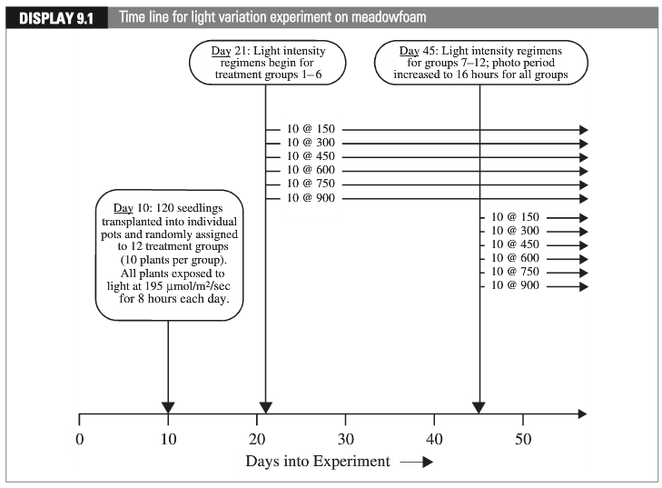
Case 1 Experimental Design: Meadowfoam
“Early”
“Late”
Data from: Seddigh, M. and G. D. Jolliﬀ. 1994. “Light Intensity Eﬀects on Meadowfoam Growth and Flowering.” Crop Science 34: 497–503.

Slide 16
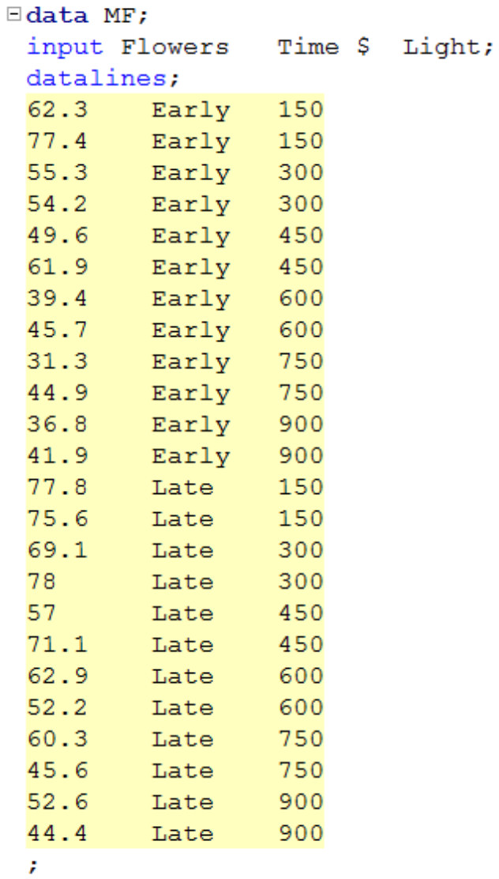
Meadowfoam: Data

Slide 17
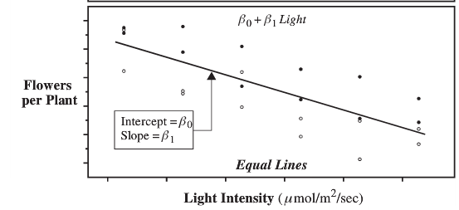
Equal Lines

Slide 18
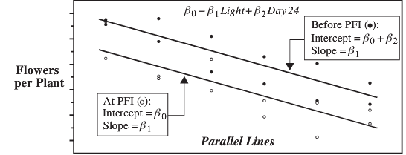

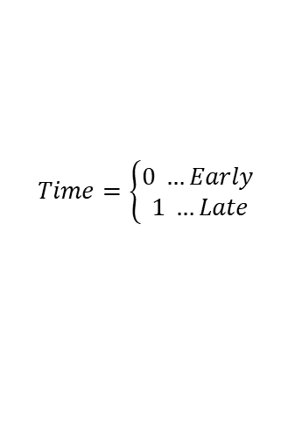









Parallel Lines: Different Intercepts, Same Slopes
$$Time=\left\{\begin{aligned}0 …Early \\ 1 …Late\end{aligned}\right.$$
$$β_{0}+β_{1}Light+β_{2}Time$$
Late
Early
$$For Time=\text{early} \left(or 0\right):$$
$$For Time=\text{late} \left(or 1\right):$$
$$β_{0}+β_{1}Light+β_{2}Time$$
$$β_{0}+β_{1}Light+β_{2}Time$$
0
$$β_{0}+β_{1}Light+β_{2}∗1$$
$$β_{0}+β_{1}Light+β_{2}∗0$$
$$β_{0}+β_{1}Light$$
$$β_{0}+β_{1}Light+β_{2}$$
slope
$$\left(β_{0}+β_{2}\right)+β_{1}Light$$
intercept

Slide 19
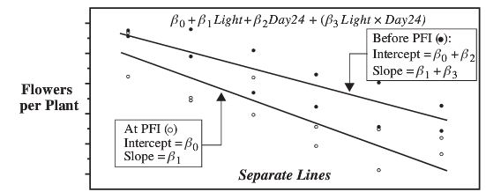






Nonparallel Lines: Different Slopes (and Intercepts)
Time is called an indicator variable:
Early = 0
Late = 1
$$β_{0}+β_{1}Light+β_{2}Time+β_{3}\left(Light x Time\right)$$
Late
Early
$$β_{0}+β_{1}Light+β_{2}Time+β_{3}\left(Time∗Light\right)$$
$$β_{0}+β_{2}Time+β_{1}∗Light+β_{3}\left(Time∗Light\right)$$
$${(β}_{0}+β_{2}Time)+{(β}_{1}+β_{3}Time)Light$$
$$For Time=\text{early} \left(or 0\right):$$
0
0
$$For Time=\text{late} \left(or 1\right):$$
$${(β}_{0}+β_{2}Time)+{(β}_{1}+β_{3}Time)Light$$
$$β_{0}+β_{1}Light$$
slope
$$\left(β_{0}+β_{2}\right)+\left(β_{1}+β_{3}\right)Light$$
intercept

Slide 20
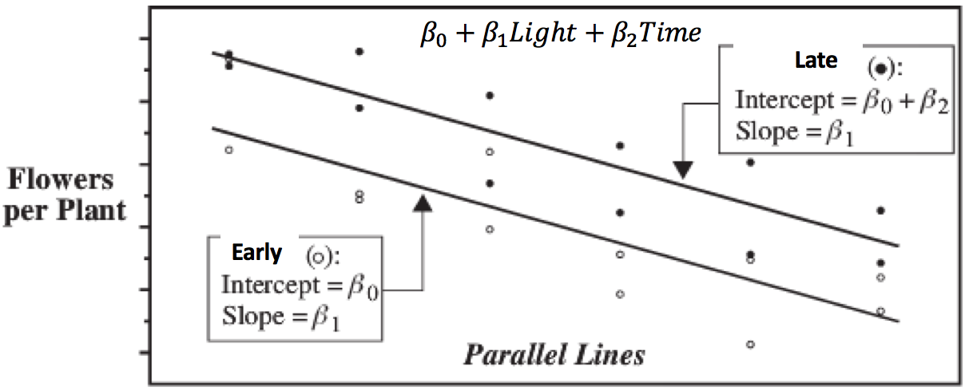
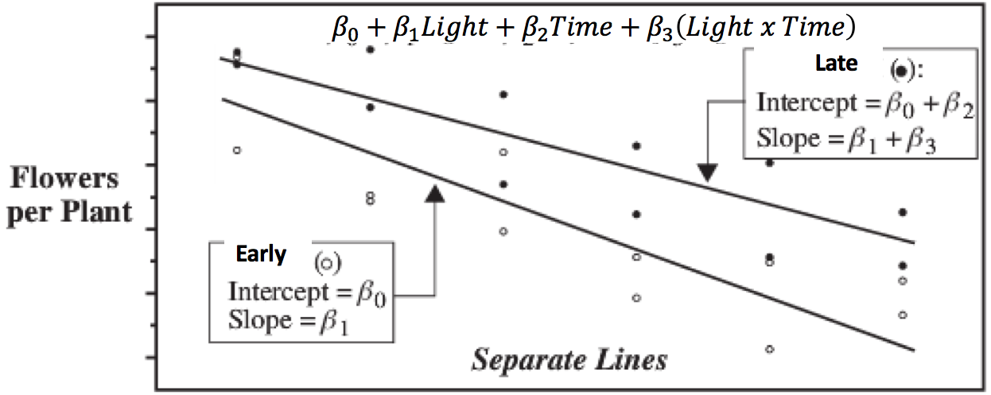
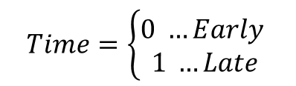
$$Time=\left\{\begin{aligned}0 …Early \\ 1 …Late\end{aligned}\right.$$
Simple linear regression
Time with no interaction
Time with interaction
Interaction means we can adjust the slope!

Slide 21

Interaction Terms! … (Flexible Slopes!)
$$μ\left\{flowers \right|light, time)= β_{0}+β_{1}Light+β_{2}Time+β_{3}\left(Light x Time\right)$$
$$μ\left\{flowers \right|light, time)= β_{0}+β_{2}Time+β_{1}Light+β_{3}\left(Light x Time\right)$$
Factor out Light and combine last two terms.
intercept
slope
$$μ\left\{flowers \right|light, time)=\left(β_{0}+{β_{2}Time)+(β}_{1}+β_{3}Time\right)Light$$
Now the intercept and the slope depend on the time!

Slide 22

Is the Separate Slope Model Appropriate?
Construct a model in which the mean flower production depends linearly on the light intensity and the time category. Also allow for the possibility of unequal slopes and intercepts.
Which model is correct?
$$Pred Flower= β_{0}+β_{1}Light$$
No possibility of unequal intercepts or unequal slopes for different time categories
$$Pred Flower= β_{0}+β_{1}Light+ β_{2}Time$$
Possibility of unequal intercepts but no possibility of unequal slopes for different time categories
$$Pred Flower= β_{0}+β_{1}Light+β_{3}Light ∗ Time$$
No possibility of unequal intercepts but has a possibility of unequal slopes for different time categories
Typically, we do not include an interaction term without relevant single terms!
$$Pred Flower= β_{0}+β_{1}Light+ β_{2}Time+ β_{3}Light ∗ Time$$
Possibility of both unequal intercepts or unequal slopes for different time categories

Slide 23
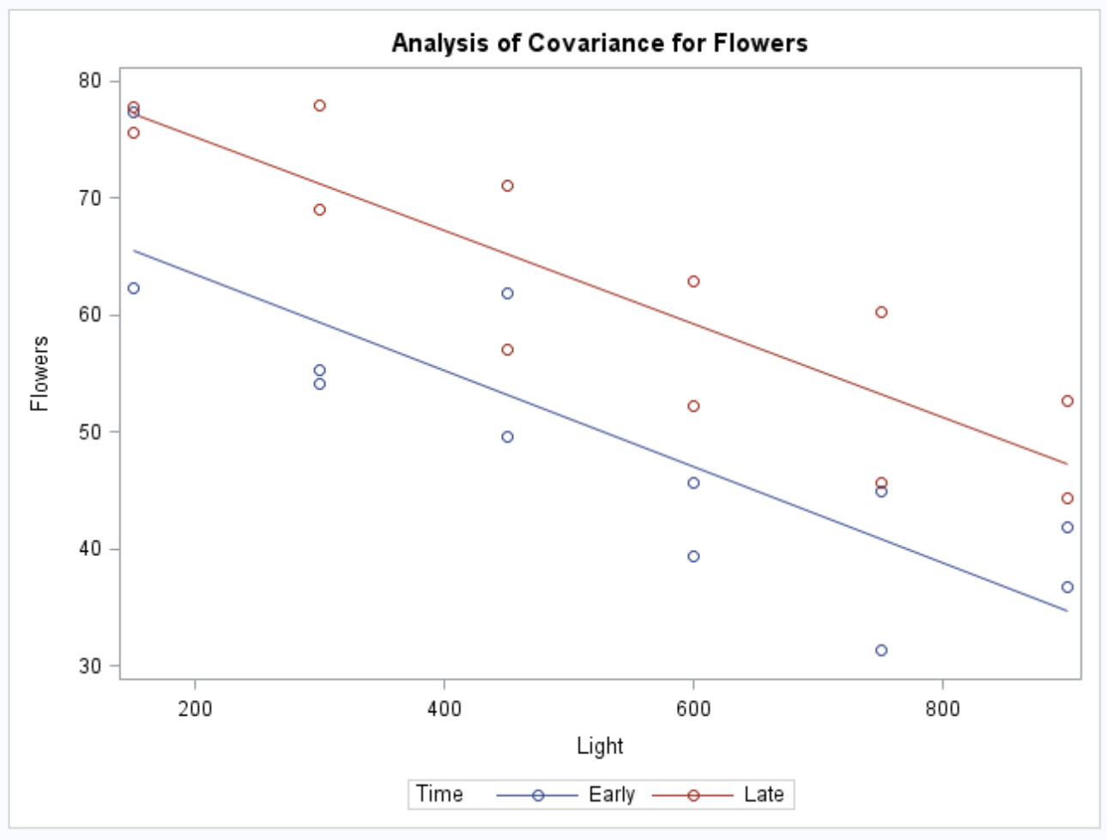
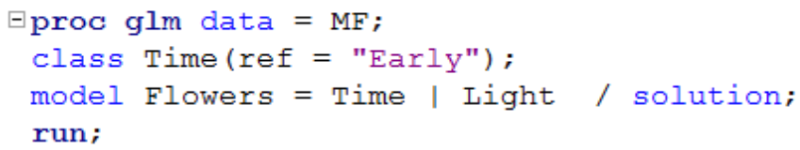
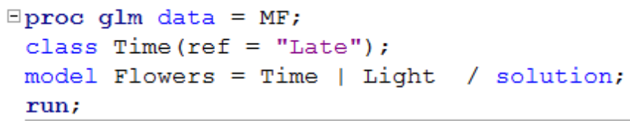
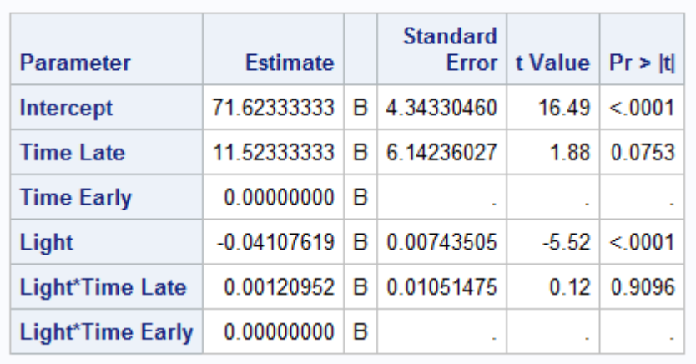
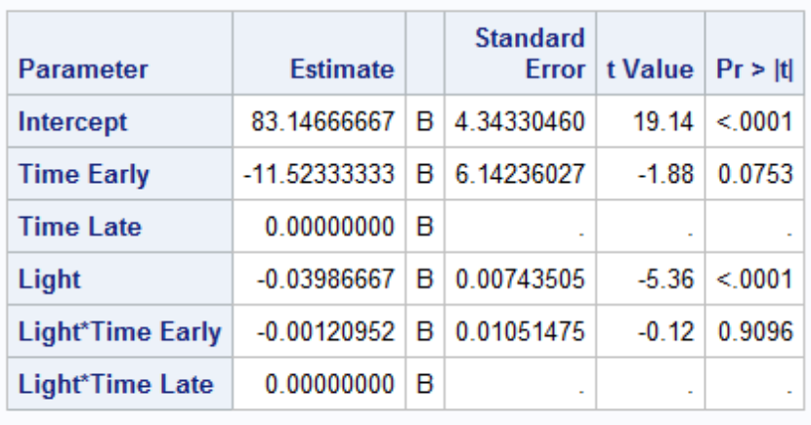
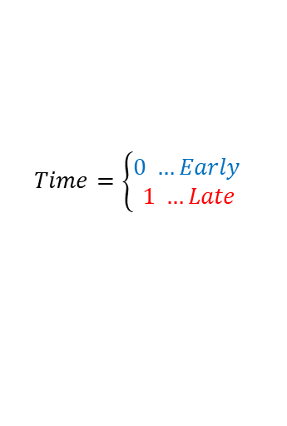
Is the Separate Slope Model Appropriate? (cont.)
Construct a model in which the mean flower production depends linearly on the light intensity and the time category. Also allow for the possibility of unequal slopes and intercepts.
$$Pred Flower= β_{0}+β_{1}Light+ β_{2}Time+ β_{3}Light ∗ Time$$
$$Time=\left\{\begin{aligned}0 …Early \\ 1 …Late\end{aligned}\right.$$
No, there is not a statistically significant difference between the two slopes. The separate slope model is not appropriate (or, $β_{3}$ is not significantly different from zero).
Rerun regression without the possibility of different slopes (without interaction term).

Slide 24
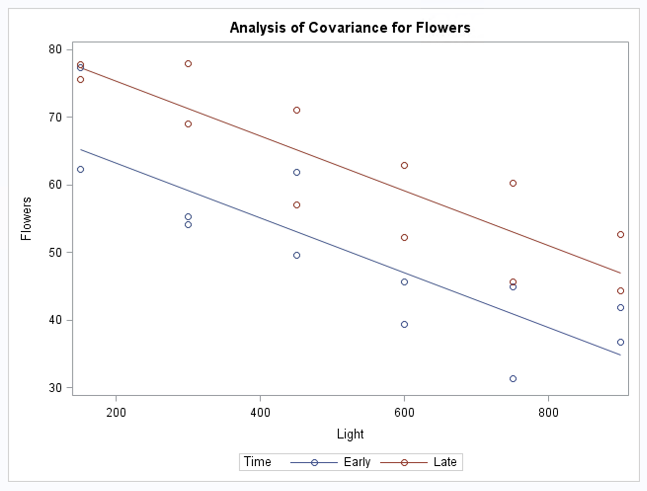
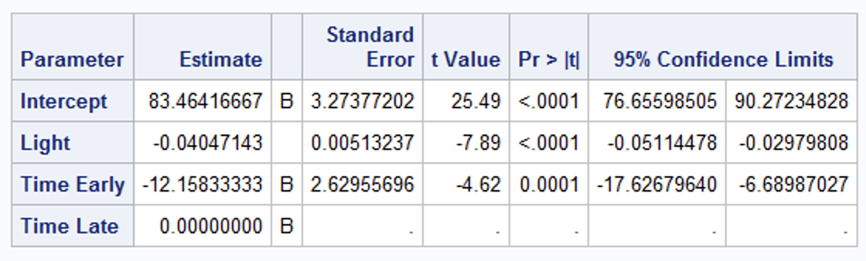
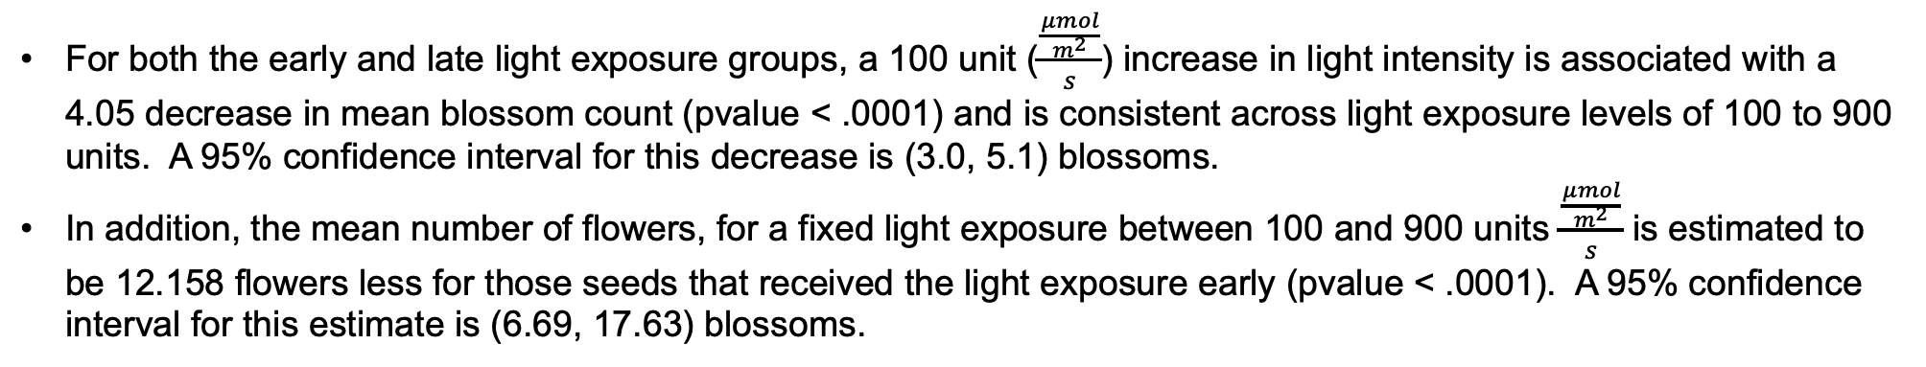
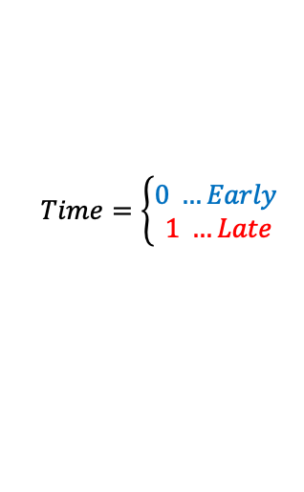
Fitting the Model Without the Interaction (Parallel Lines)
$$Pred Flower= β_{0}+β_{1}Light+ β_{2}Time$$
$$Time=\left\{\begin{aligned}0 …Early \\ 1 …Late\end{aligned}\right.$$
proc glm data = MF;
class Time;
model Flowers = Light Time / solution clparm;
run;
For both the early and late light exposure groups, a 100 unit ($\frac{\frac{μmol}{m^{2}}}{s}$) increase in light intensity is associated with a 4.05 decrease in mean blossom count (pvalue < .0001) and is consistent across light exposure levels of 100 to 900 units. A 95% confidence interval for this decrease is (3.0, 5.1) blossoms.
In addition, the mean number of flowers, for a fixed light exposure between 100 and 900 units $\frac{\frac{μmol}{m^{2}}}{s}$ is estimated to be 12.158 flowers less for those seeds that received the light exposure early (pvalue < .0001). A 95% confidence interval for this estimate is (6.69, 17.63) blossoms.

Slide 26
Example
Charity Part I

Slide 27
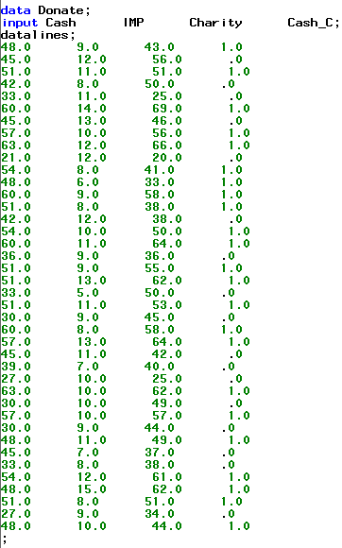
Example Where Interaction Matters
This is a data set that records the amount of cash someone makes (cash in $1,000s) and the amount of money they give to charity (charity in $1s) based on the importance (Imp) each subject attributes to charity. Cash_C is a variable that indicates if the person makes over $45,000.
Indicator variableCash_C:
0: <= $45,000
1: > $45,000

Slide 28
Example Where Interaction Matters (cont.)
Charity in $s
Construct a multiple linear regression model in which the mean charitable donation depends (linearly) on the importance of the charity and both income groups. Allow for possible different slopes and intercepts.
Cash in $1,000s
Cash_C:
0: <= $45,000
1: > $45,000
$Predicted Charity= β_{0}+β_{1}Imp+ β_{2}Cash_{C}+ β_{3}Cash_{C}$ * $Imp$

Slide 29

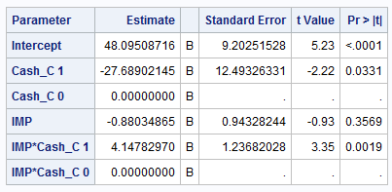
Concept Check
$Predicted Charity= β_{0}+β_{1}Imp+ β_{2}Cash_{C}+ β_{3}Cash_{C}$ * $Imp$
Cash_C:
0: <= $45,000
1: > $45,000
Write two equations for the regression of charity on importance … one for each value of Cash_C.

Slide 31
Example
Charity Part II

Slide 32
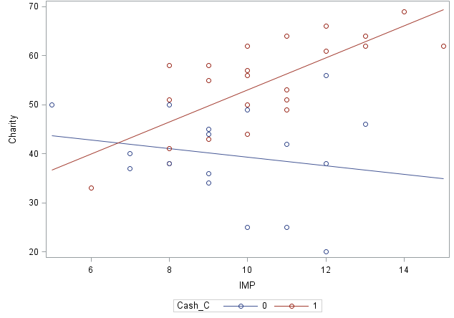
Fit the Model
Cash_C:
0: <= $45,000
1: > $45,000
Include all lower order terms that are included in a significant interaction!
Check the highest order terms first!
$Predicted Charity= β_{0}+β_{1}Imp+ β_{2}Cash_{C}+ β_{3}Cash_{C}$ * $Imp$
Predicted Charity = 48.10 − .88 Imp − 27.68 Cash_{C} + 4.15 Cash_{C} * Imp
intercept
slope
Predicted Charity = (48.10 − 27.68 Cash_{C}) +(−.88 + 4.15 Cash_{C}) Imp
<=$45,000
Predicted Charity = 48.10 − 0.88 importance
>$45000
Predicted Charity = 48.10 – 27.68 * 1 + (−0.88 + 4.15 * 1) importance

Slide 33

Explanation
Cash_C:
0: <= $45,000
1: > $45,000
Predicted Charity = 48.10 − .88 Imp − 27.68 Cash_{C} + 4.15 Cash_{C} * Imp
Predicted Charity = 48.10 − 27.68 Cash_{C} − .88 Imp + 4.15 Cash_{C} *Imp
Factor out Imp and combine the last two terms.
intercept
slope
Predicted Charity = (48.10 − 27.68 Cash_{C}) + (−.88 + 4.15 Cash_{C}) Imp
For low income (Cash_C = 0):
0
0
Predicted Charity = 48.10 − 27.68 * 0 + (−0.88 + 4.15 * 0) Importance
Predicted Charity = 48.10 − 0.88 Importance
For high income (Cash_C = 1):
Predicted Charity = 48.10 – 27.68 * 1 + (−0.88 + 4.15 * 1) Importance
Predicted Charity = 20.42 + 3.27 Importance

Slide 34
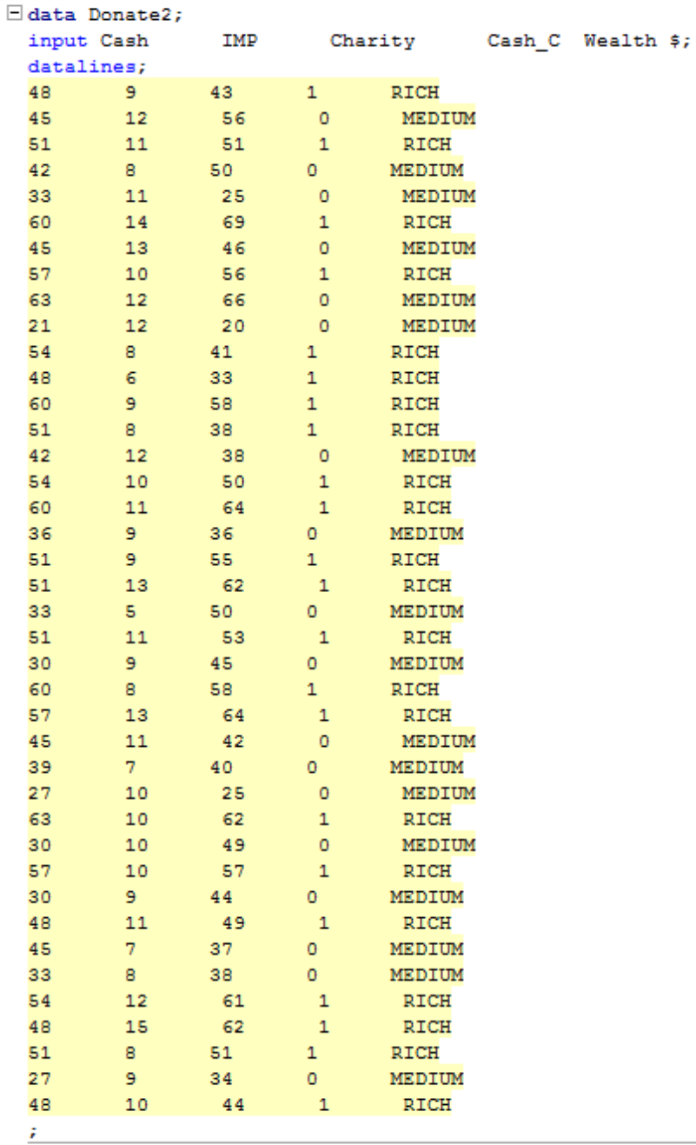
Charity, Cash (Dichotomous), and Perceived Importance: Recoded!

Slide 35


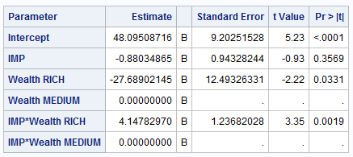
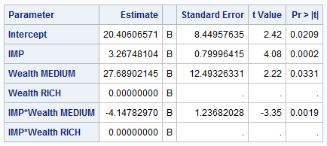
Charity and Perceived Importance: Easier Read and Interpretation
$$Predicted Charity= β_{0}+β_{1}Imp+ β_{2}Rich+ β_{3}Rich∗Imp$$
Depending on which value is chosen as the reference (rich or medium), the betas will be different but the individual regression equations will be the same. (Try it!)
Remember to include all terms that are included in an interaction!
Predicted (Charity|Wealth = Medium) = 48.09 − 0.88 Importance
Predicted (Charity|Wealth = Rich) = 20.41 + 3.27 Importance

Slide 37
Charity Example Part III
Interpretation

Slide 38
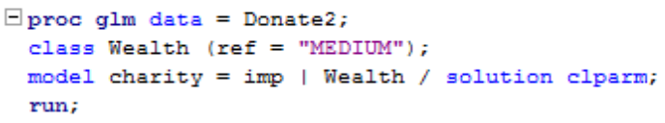
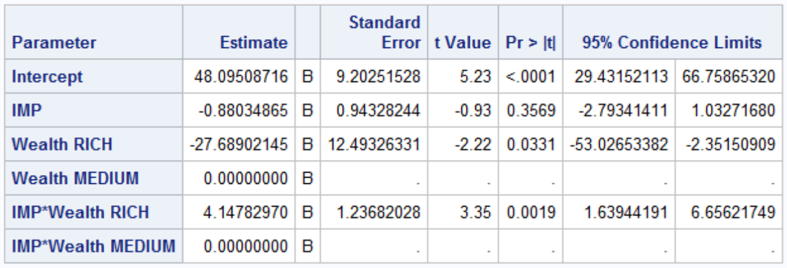
Charity and Perceived Importance: Easier Read and Interpretation
Wealth is still a dichotomous variable. SAS will treat it like an indicator variable.
$$Predicted Charity= β_{0}+β_{1}Imp+ β_{2}Cash_{C}+ β_{3}Imp∗Cash_{C}$$
MEDIUM
RICH
Predicted Charity = 48.10 − 0.88 Importance
Predicted Charity = 20.41 + 3.27 Importance
A wealthy individual is predicted to donate on average $27.69 less than a person of medium wealth when the importance of the charity is negligible (p-value = .0331). However, this is extrapolation, the lowest importance score in the data is 5.

Slide 39
Charity and Perceived Importance: Easier Read and Interpretation
Wealth is still a dichotomous variable. SAS will treat it like an indicator variable.
$$Predicted Charity= β_{0}+β_{1}Imp+ β_{2}Cash_{C}+ β_{3}Imp∗Cash_{C}$$
MEDIUM
RICH
Predicted Charity = 48.10 − 0.88 Importance
Predicted Charity = 20.41 + 3.27 Importance
A wealthy individual is predicted to donate on average $27.69 less than a person of medium wealth when the importance of the charity is negligible (p-value = .0331). However, this is extrapolation, the lowest importance score in the data is 5.
The meaningful inference is that it is estimated that for each unit of importance more a wealthy person feels a charity is, he or she will on average donate $4.14 more than a person of medium wealth (p-value = 0.0019). A 95% confidence interval for this estimate is ($1.64, $6.66).

